Slide 1
Balloch Castle Country Park Regeneration Group
Businesses Engagement Questionnaire Report

Slide 2
Agenda
Survey Introduction
Responses from Businesses
Insight on Responses
Conclusion

Slide 3
Survey Introduction
Balloch Castle Country Park Regeneration Group carried out a survey in 2022 to create awareness and encourage action to reverse the decline of Scotland’s historic natural identity, biodiversity, and the nature services upon which we all rely.
We received over 250 responses from park users.
We decided to carry out another survey to focus on the expertise of the local business community to open discussions around how the Park could generate income to become self-sustaining and how the Castle can be brought back into use.

Slide 4
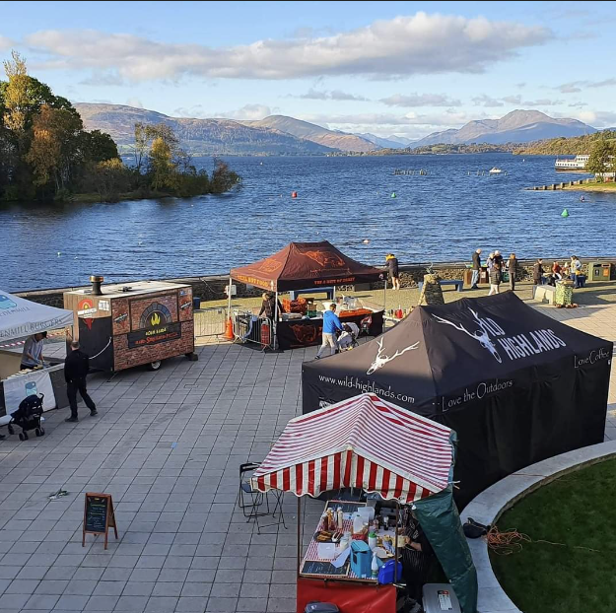
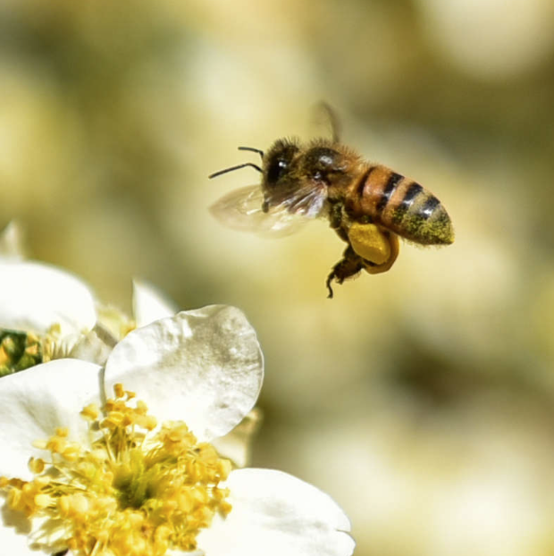
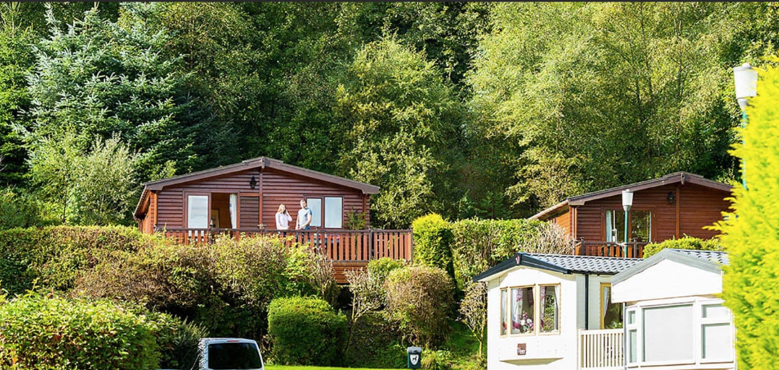
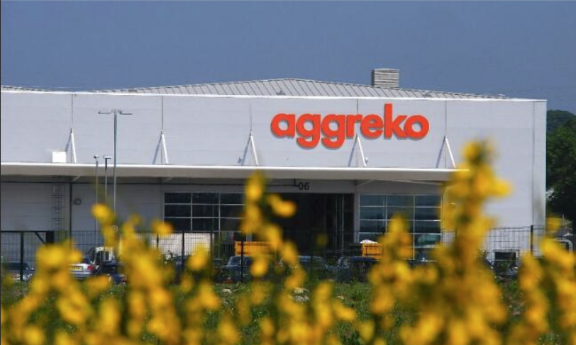
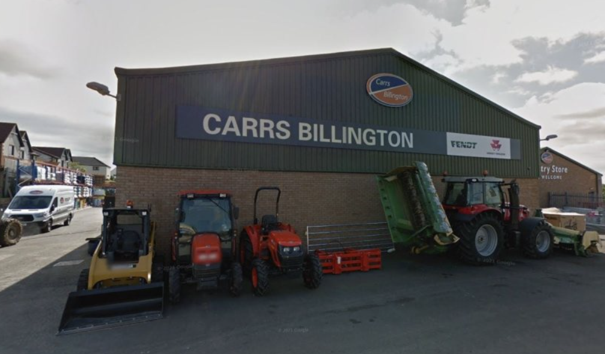
Business Response
So far, we have engaged with Six businesses who have provided us with valuable insight into their view on Balloch Park.

Slide 5
Insight to some Questions and Responses
Q. What do you like about Balloch Castle Country Park (BCCP) and how does your business benefit from having the Park nearby (think about your customers, staff and the wider,
Response - As a personal user, I walk, run, swim in the Park and enjoy doing so. My Wild Highlands Coffee business benefits as it is visible from the Park and visitors come to my premises as a result of being in the Park. My Bee School business benefits as the Park contains native pollinator species, which are in decline. I'm happy that INNS are being removed from the Park.,

Slide 6
Insight to some Questions and Responses
Response - Balloch park is a beautiful area right on our doorstep and we encourage visitors to our Lomond gate Manufacturing site to visit and see the beauty of Loch Lomond. Being a worldwide company we have visitors from all over the world who are keen to see Loch Lomond and we would recommend a walk in Balloch Park before/after work to clear your head and see the beauty of the area. Being local myself I live basically next door to Balloch Park, and I have been on Sweeney’s Cruise a few times Balloch Park and the castle are obviously something the highlight but the castle bit of eye sore.

Slide 7
Insight to some Questions and Responses
Q. In our Park users’ survey last year people emphatically stated they want to see the Castle and other built assets in the Park restored and brought back into use. How do you think……
Response - The leaseholder needs to be more responsive to local business proposals and encourage and accommodate them. Start-up companies need a more entrepreneurial approach to support.

Slide 8
Insight to some Questions and Responses
Q. In our Park users’ survey last year people emphatically stated they want to see the Castle and other built assets in the Park restored and brought back into use. How do you think……
Response - I think this would be a great idea - having it open with memorabilia and historical items from the area including maid of the loch, old bear park, Sweeneys cruises, details of events / concerts etc that have happened at the park - I feel this would all be of great interest to people. Then the possibility of renting spaces out to business etc or a tea room, restaurant, events space (weddings and events) etc

Slide 9
Conclusion
For more information about BCCPRG please see https://ballochparkregen.co.uk/
Check out our Balloch Park Nature Restoration Plan at https://ballochparkregen.co.uk/wp-content/uploads/2023/03/BCCP-Nature-Restoration-Plan-2023-Riverwoods-Web-Final.pdf
or email us at bccpregengroup@gmail.com
Thank you!

