Slide 1

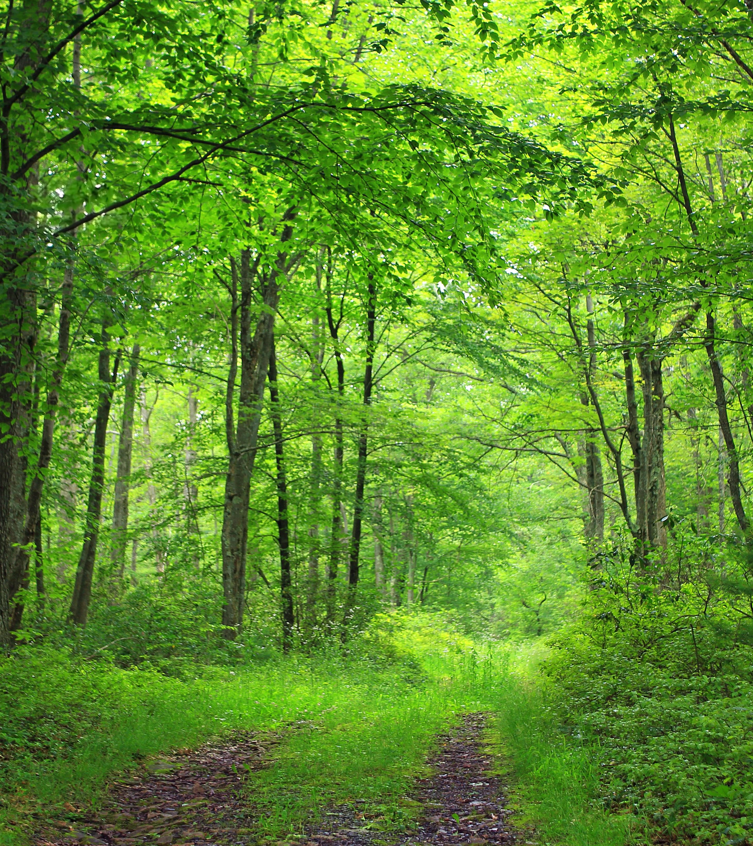
A PLAN FOR ACTION 2024 - 2034
BALLOCH CASTLE COUNTRY PARK REGENERATION GROUP 05.09.24

Slide 2
Why have an action plan?
To help the Balloch Castle Country Park Regeneration Group achieves its mission: using short term (1-2 years), medium term (3-5 years) and long term actions (6 - 10 years
To help make Balloch Castle Country Park a place to live well, respectfully enjoy our environment and learn how to help protect life on Earth. The Balloch Castle Country Park Regeneration Group will bring stakeholders and park users together to restore nature, heritage and recreational assets and explore income generation opportunities. Our focus will be on health and wellbeing, enhancing biodiversity in the Park, supporting national targets to tackle global warming and recognising the essential contribution of those who maintain the Park.
These actions are categorised under the following headings:
Improving and maintaining Natural Assets
Improving and maintaining Built Assets / Services and Facilities
Governance, communication, fund raising, community engagement and partnership work

Slide 3
How will we use the action plan?
The plan will be used in the following ways:
To prioritise actions and projects to achieve the aims and objectives of BCCPRG
To inform partnership working with WDC and other key stakeholders
To engage group members, partners and volunteers’ involvement with BCCPRG
To help structure partnership meetings with West Dunbartonshire Council (WDC)
To help to measure success of the BCCPRG
To help direct BCCPRG fund-raising campaigns and give confidence to funders
Once actions have been agreed a project scoping document will be created

Slide 4
How will we manage the action plan?
Reviewed and refreshed annually with agreement of the Management Committee Members
Updated quarterly prior to BCCPRG members meetings and will form the basis for the agenda for those meetings
Discussed and agreed by members at the 1st members meeting after the start of the new financial year
Shared at the Annual General Meeting and form the basis for discussion

Slide 5
How is the plan formed?
Continuous engagement with the local community, communities of interest and park users
The BCCPRG Mission Statement and the charitable purposes
The BCCPRG Constitution
Any relevant planning document or research undertaken by BCCPRG or other partner organisations that relate to the future management of Balloch Castle Country Park

Slide 6
What is in this plan? (examples)
SHORT-TERM (1- 2 years)
Work with CHAS and WDC to improve the use of the walled garden (including art project and sensory elements).
Support WDC in the implementation of the INNS removal and woodland management plan
Assist WDC by undertaking outdoor recreation infrastructure survey and minor improvements
Work with CHAS to establish pop up café in vicinity of the castle to generate funding for projects
Work with partners to undertake a Masterplan for the BCCP to help guide and prioritise further investment over the next 10 years
Explore options for a dedicated member of staff to help develop, drive and deliver the BCCPRG Action Plan
MEDIUM-TERM (3 - 5 years)
Expand work with CHAS and WDC in the walled garden (Including arbour restoration, expansion of new beds and structural survey of wall and removal of harmful vegetation).
Undertake repeat of Park User Survey in 2028
Work with WDC to fund and install additional public toilets in the vicinity of the slipway.
Work with WDC to bring the castle café back into use alongside a viewing platform (limited opening) building on the work of the masterplan to bring the rest of the building back into use.
Raise funds for studies / feasibility, design and installation for toilets, pavilion and events space, and castle (Phase 1)
LONG-TERM (6 -10 years)
Expand work with CHAS and WDC in the walled garden (Including arbour restoration, expansion of new beds and structural survey of wall and removal of harmful vegetation).
Work with WDC to bring additional areas of the castle into use
Increase membership active (volunteers) (30) and passive supporters (220)
Raise funds for studies / design and of pavilion and events space/ castle phase 2 / staff member

Slide 7
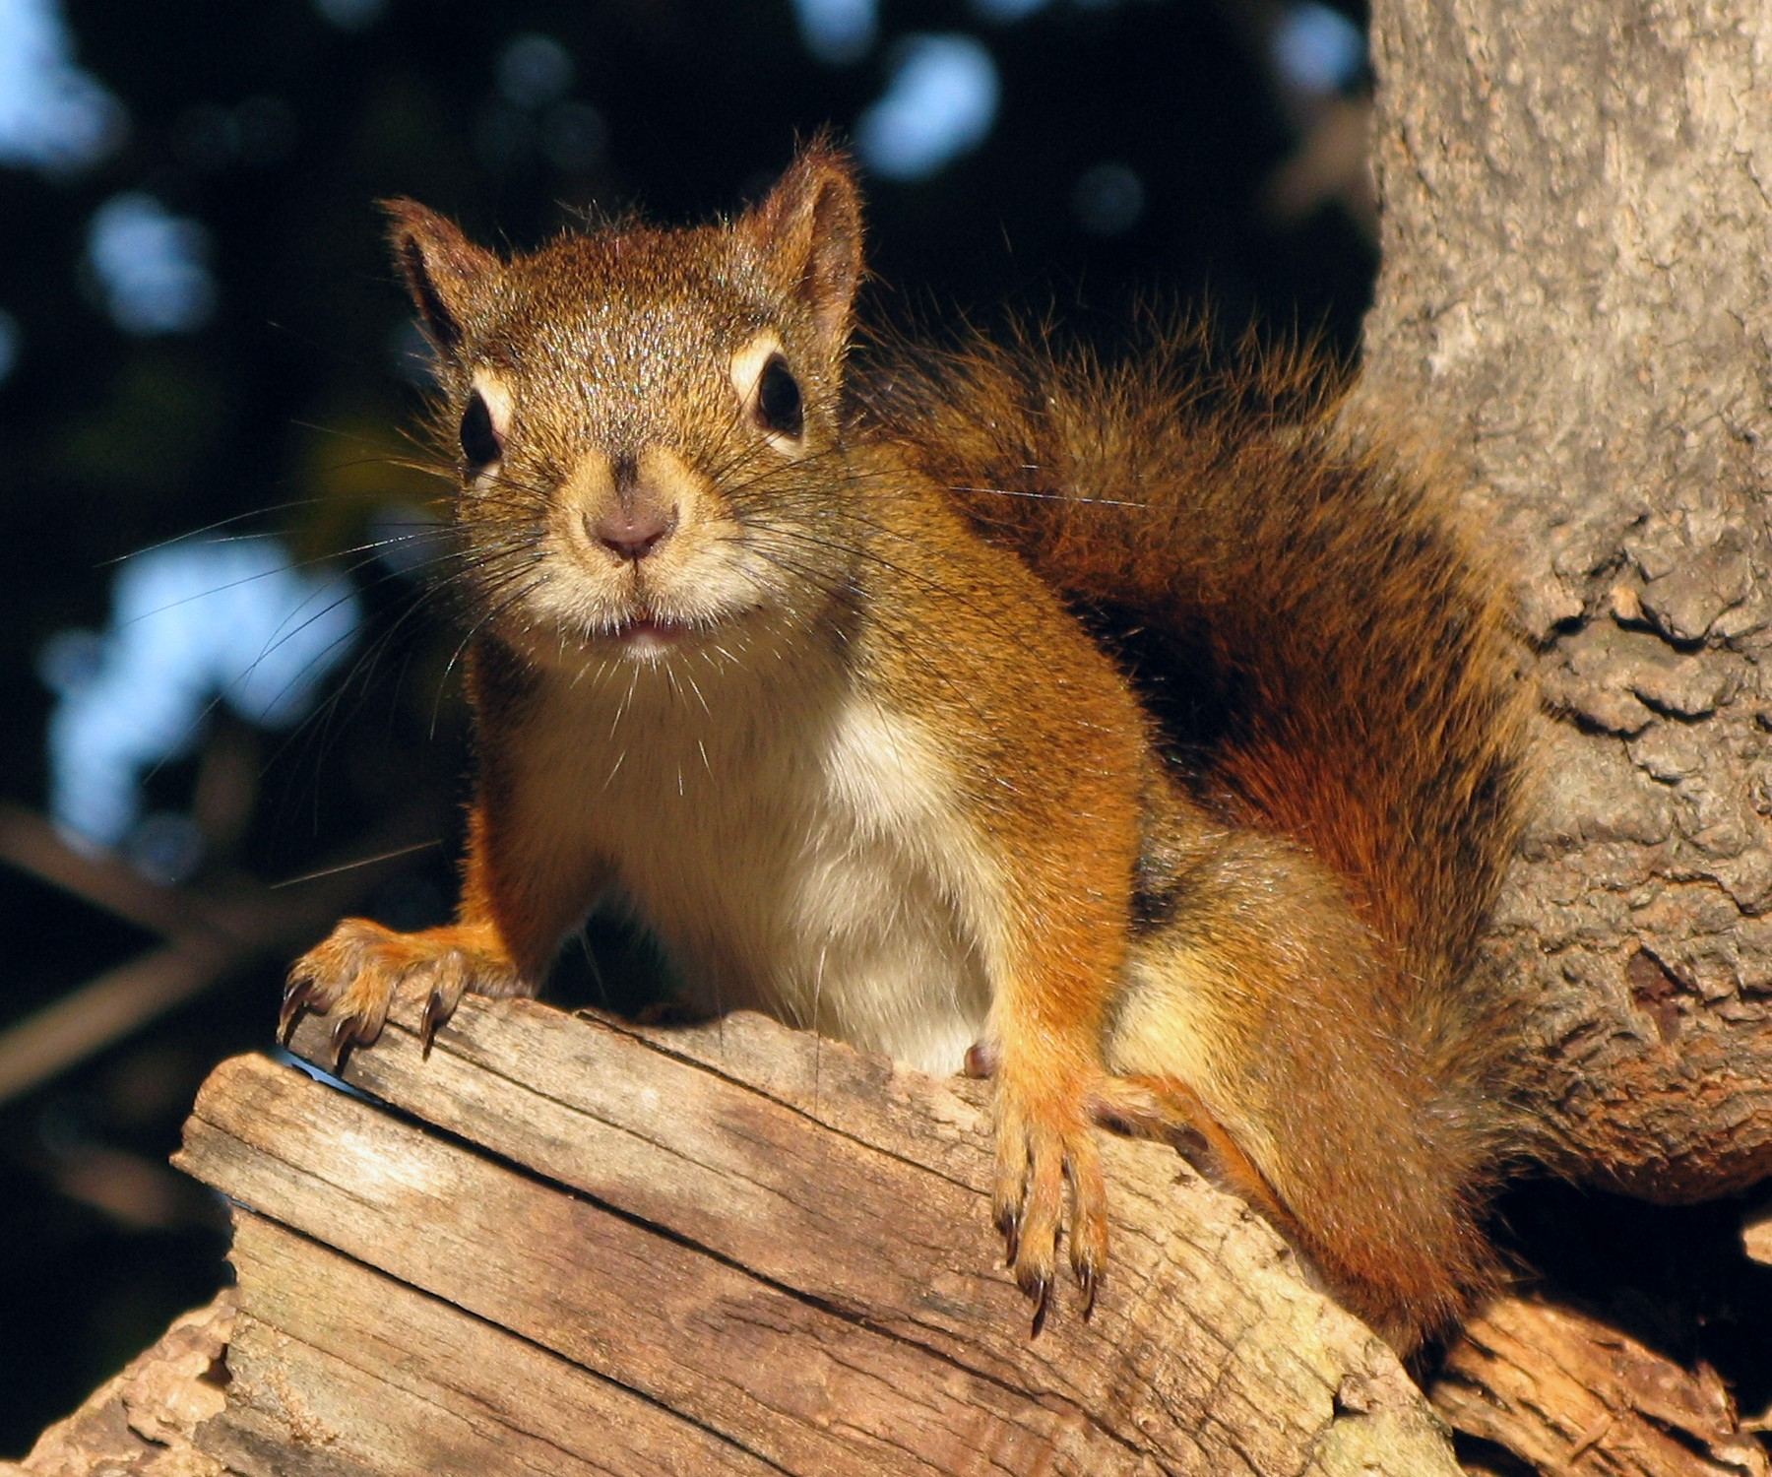
ANY questions?

